Slide 1
ECE 432 Microwave Circuit Design II
Michael | Jackson

Slide 2
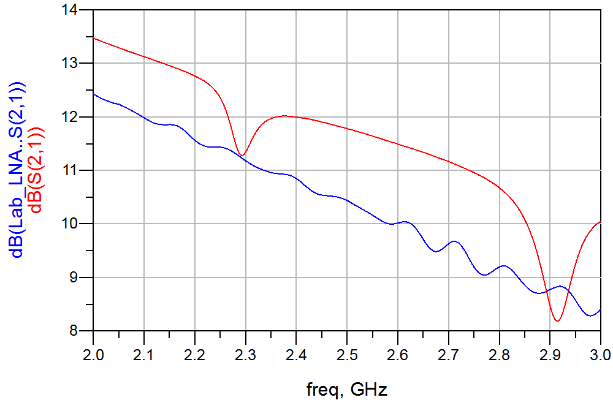
LNA Measurements

Slide 3
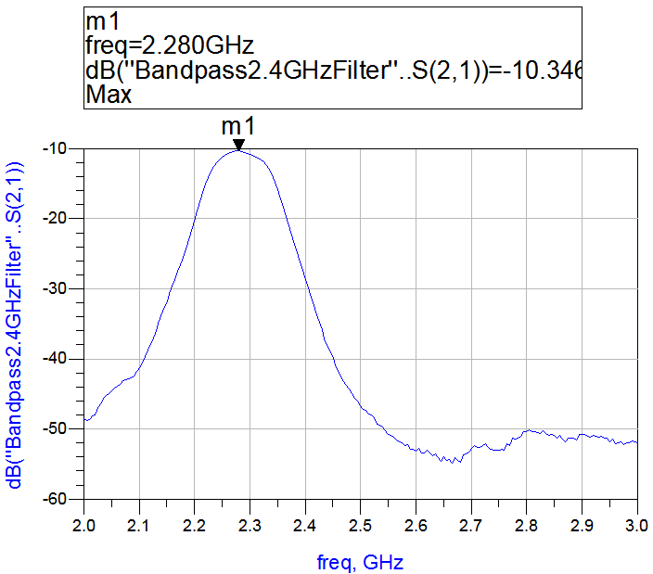
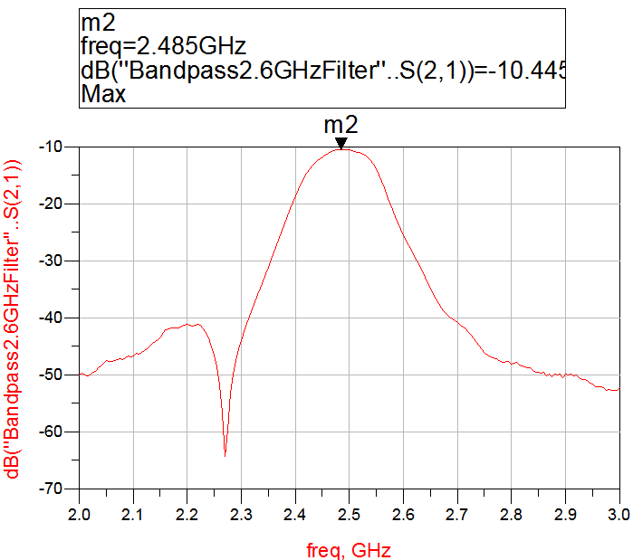
Bandpass Filter Measurements
2.4 GHz
2.6 GHz

Slide 4
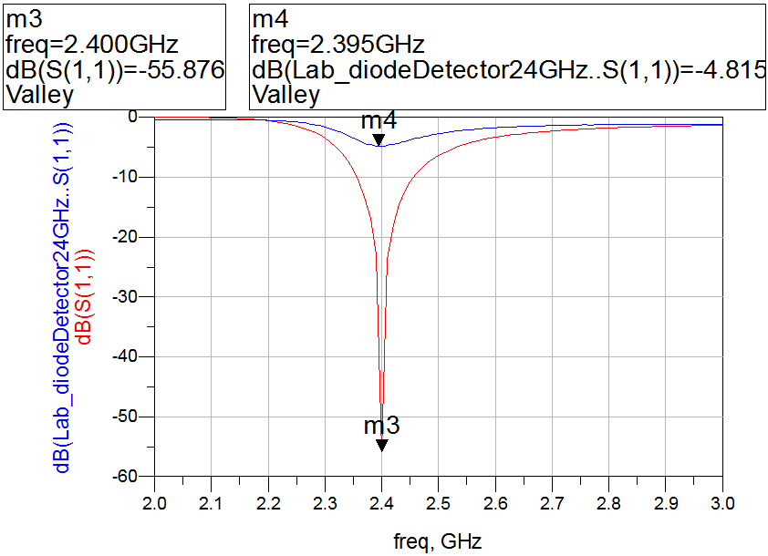
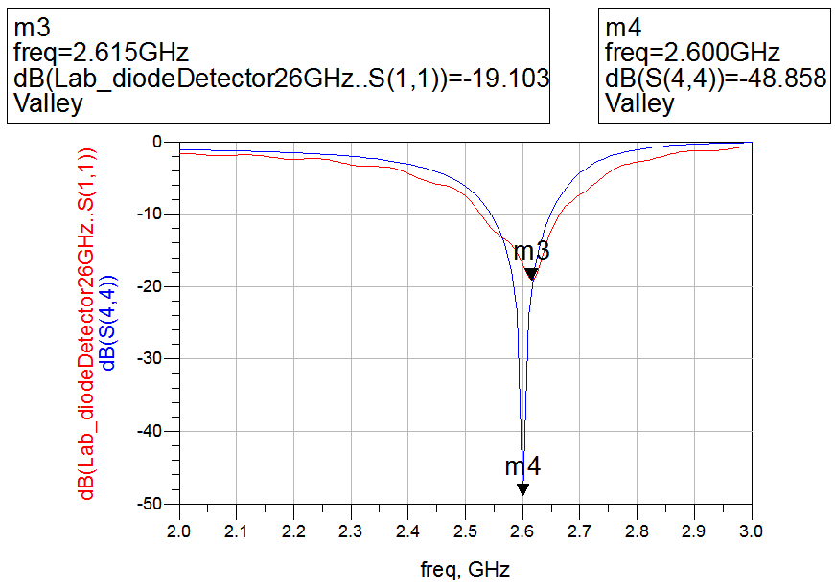
Diode Detector Measurements
2.4 GHz
2.6 GHz

Slide 5
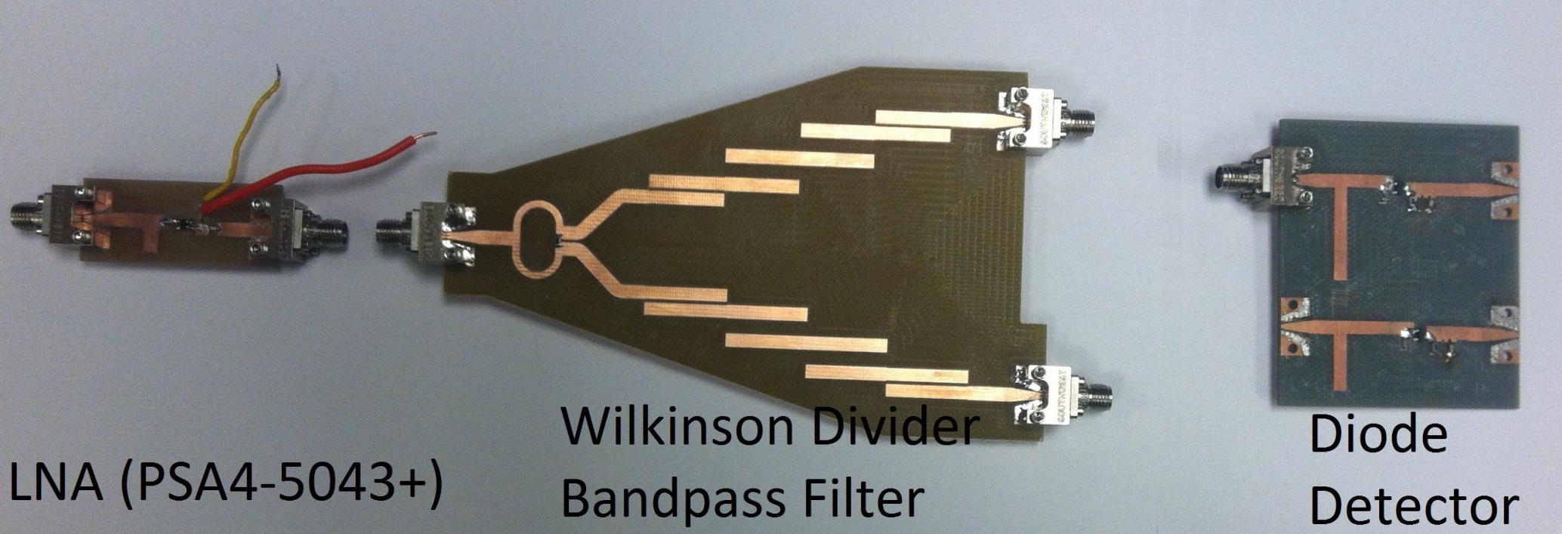
FSK Receiver

Slide 6
Lessons Learned
Using ADS built-in tools (e.g. Smith Tool, WDCoupler)
Designing matching networks for a particular frequency

Slide 7
Questions & Answers
[Insert cricket sound here]

